Slide 1

Predicting Accident Severity with Machine Learning: A Critical Weapon in Emergency Management of Road Traffic Accident
Ferdinand Che

Slide 2
Report Overview
Business Understanding
Objective & Approach
Data Understanding
Methodology
Presentation of Results
Discussion
Conclusion

Slide 3
Business Understanding
Road traffic accidents (RTAs) and the associated injuries are a significant public health challenge in countries worldwide
About 1.25 million people and up to 50 million people are injured yearly, and RTAs represent the 10th leading cause of death globally
RTAs are also the number one cause of mortality of the young between the ages of 5 and 29
Especially in developing countries where timely pre-hospital emergency care and subsequent transportation of accident victims to appropriate health facilities are often limited
Timely and appropriate medical care of RTA victims can significantly reduce accident and injury outcomes
RTA victims’ survival can be significantly improved if they are attended to in a timely manner and cared for by appropriate and qualified medical personnel (Sam et al., 2019)

Slide 4
Objective & Approach
To predict accident severity using machine learning (ML) and factors associated with RTAs
Capturing such information could help emergency management teams enabling them to predict accident severity, to dispatch of appropriate emergency equipment, vehicle, and personnel or to provide appropriate and timely guidance to the nearest health facility
Such a capability would empower emergency management teams, trauma centers, and ultimately lead to improvements in road traffic safety, even in remote areas with limited access or emergency services

Slide 5
Data Understanding
Data was obtained from a publicly available dataset provided by the Seattle Depart of Transportation (SDOT)
Collisions data containing weekly information about accidents in Seattle City for all collision types from 2004 to present
Dataset contains a total of 40 attributes, such as the location of the collision, collision type, date and time of collision, and other attributes relevant to RTAs
Dataset needed to be cleaned and prepared to be valid for Machine Learning model development and testing

Slide 6
Methodology
Exploratory Analysis & Visualization
Various visualization techniques and tools used to understand the nature of the dataset attributes (e.g. Pandas and Seaborn)
Data Cleaning, Preparation, and Transformation
Removing rows with missing data, binarization, and binning
Data Transformation
Standard scalers used to transform the data
Decision Tree algorithm used for feature selection
PCA used for dimensionality reduction
Scikit-Learn for Model Development and Testing

Slide 7
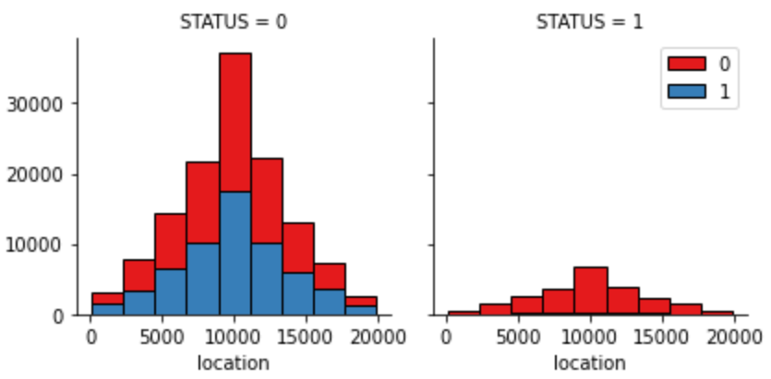
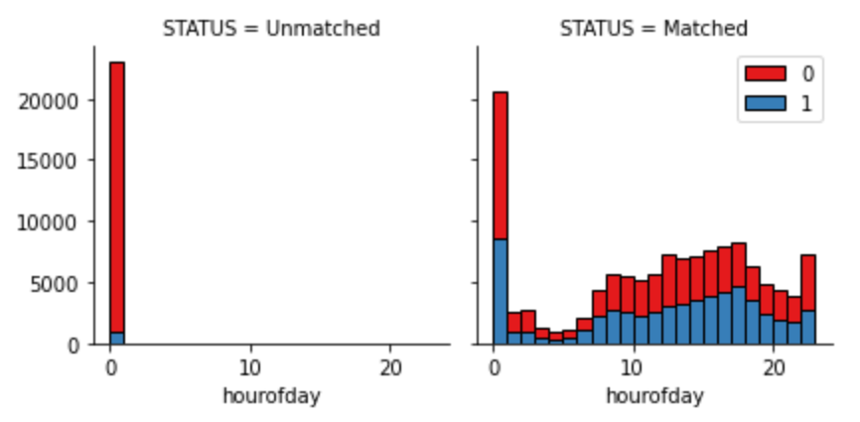
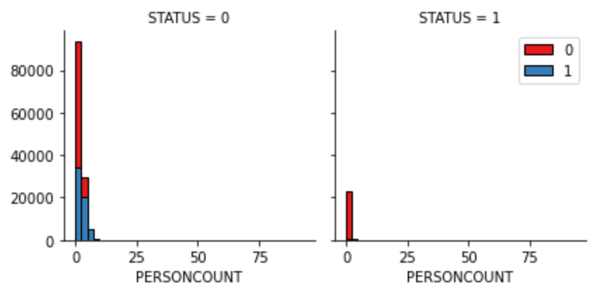
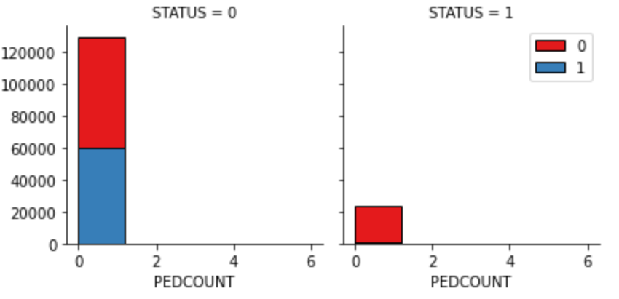
Distribution of collisions by location, hour of the day, person count, and pedestrian count

Slide 8
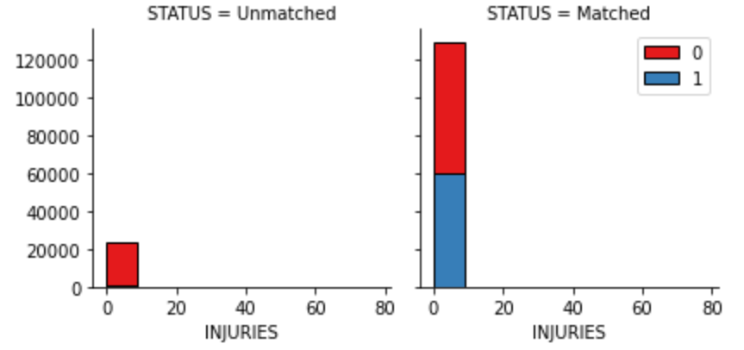
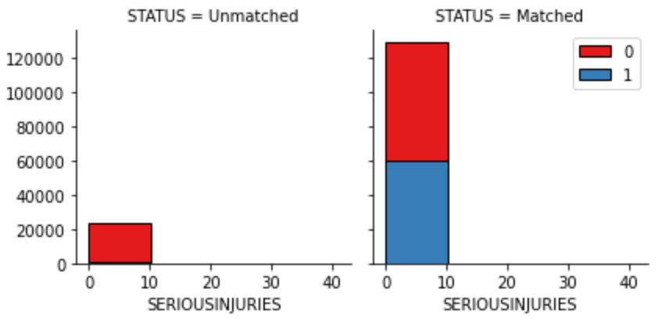
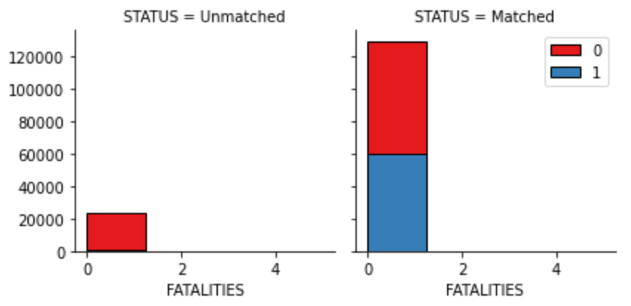
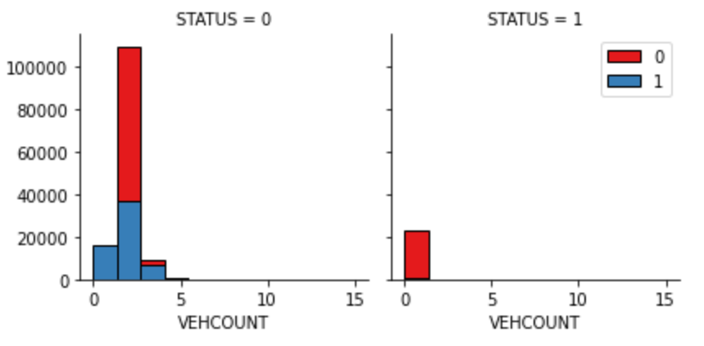
Collisions by number of injuries, serious injuries, fatalities, and number of vehicle involved

Slide 9
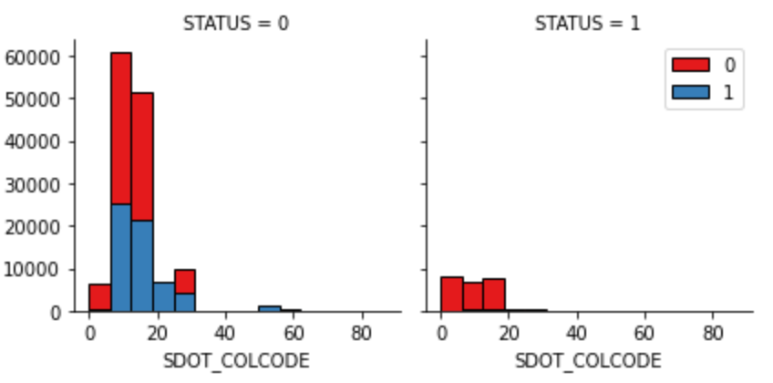
Collisions by SDOT code and serious injuries

Slide 10
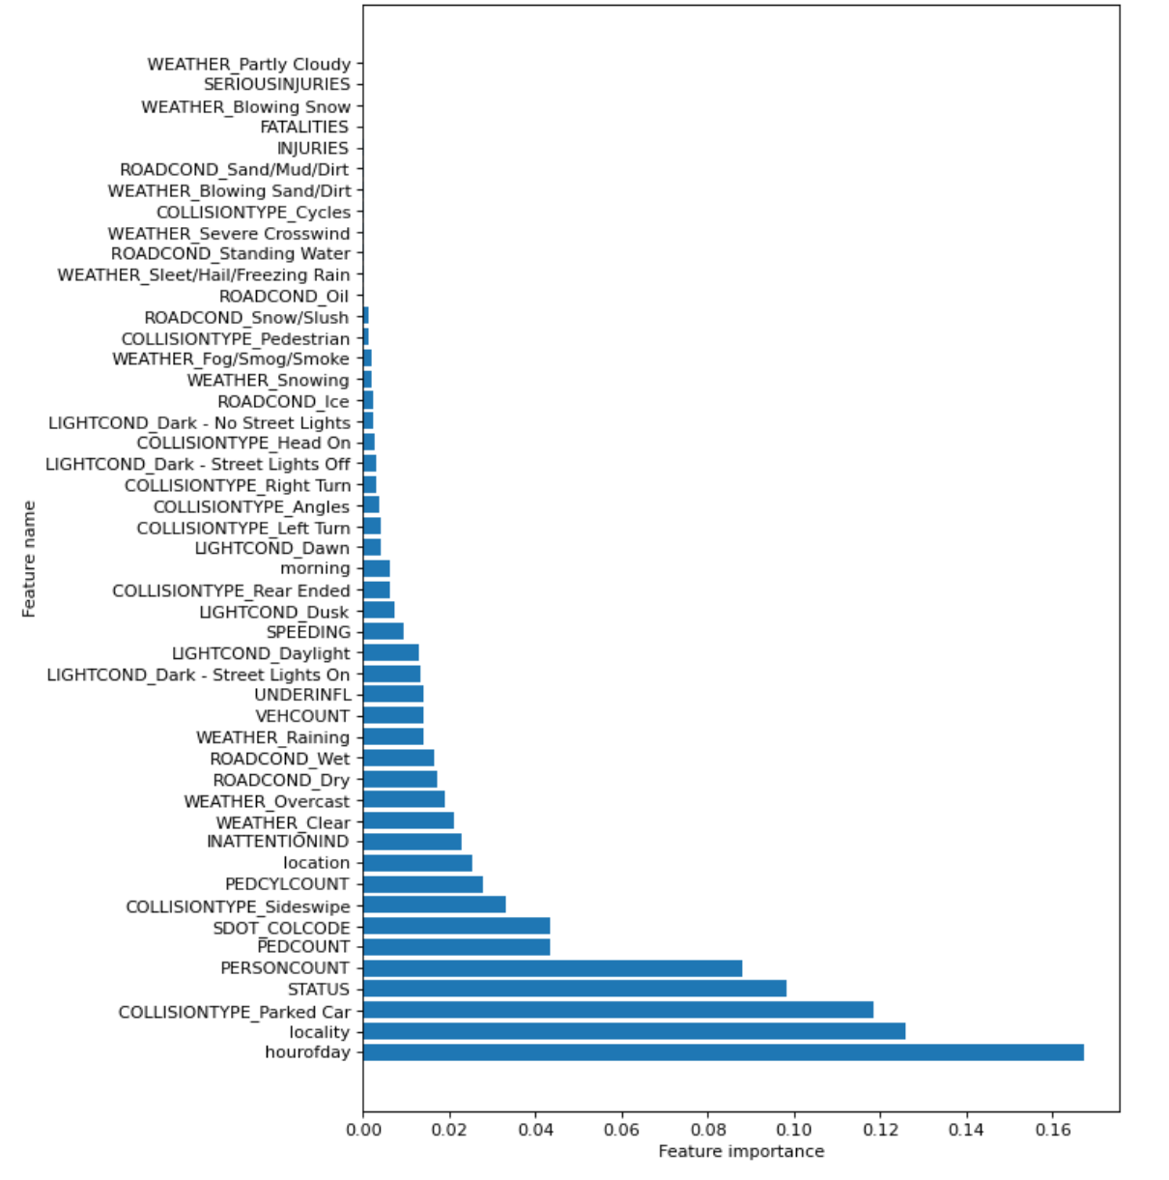
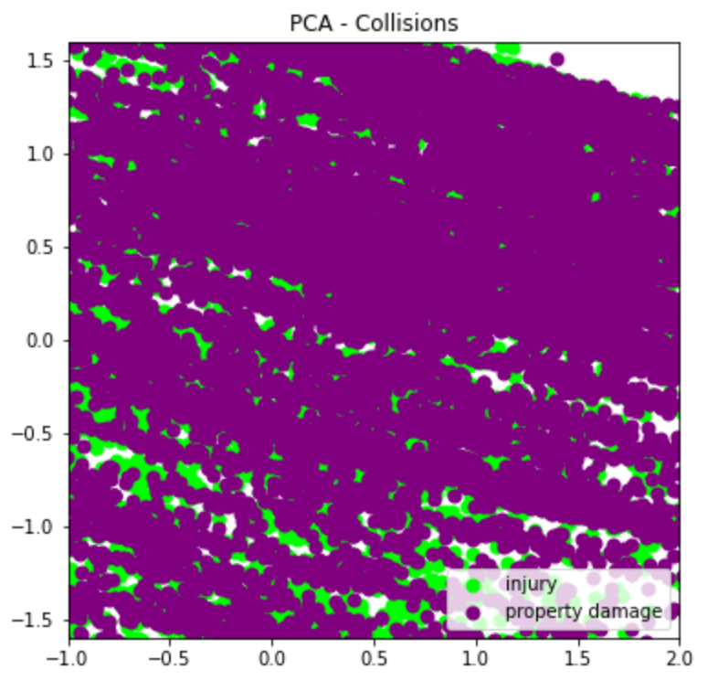
Feature importances in ascending order and the scatter plot for the two classes

Slide 11
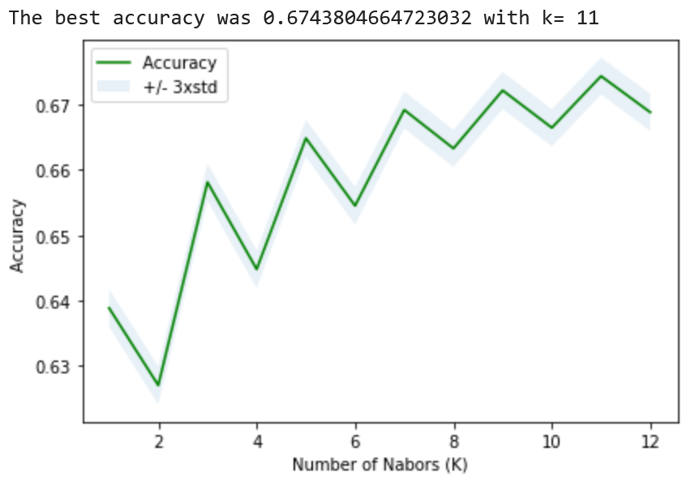
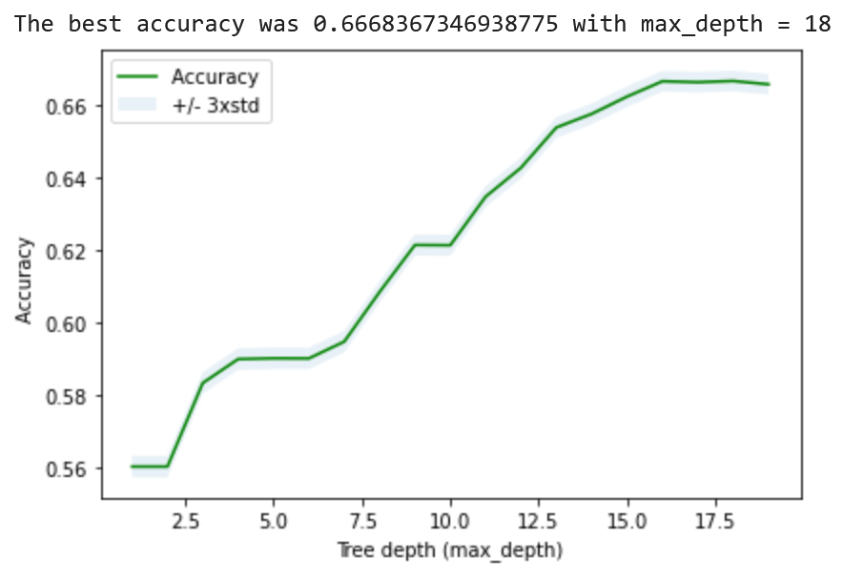
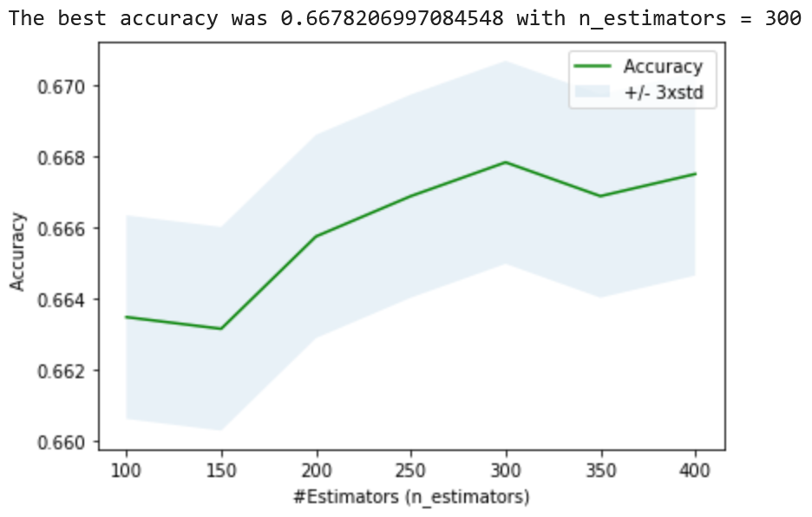
KNN
DT
GBDT (max_depth=5, learning_rate=0.2)
Plots of the optimal parameter for the three algorithms

Slide 12
Training & Evaluation Performance Scores
Final Model Cross-Validation Scores

Slide 13
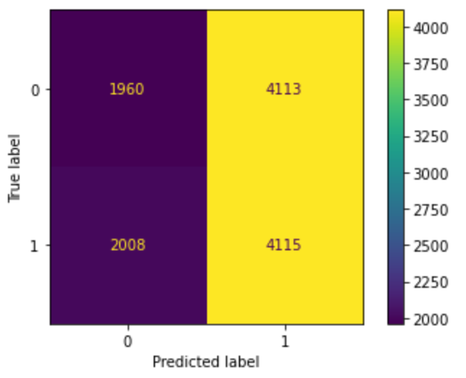
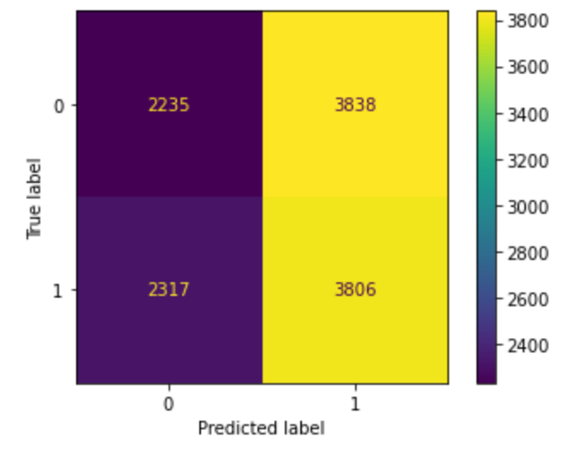
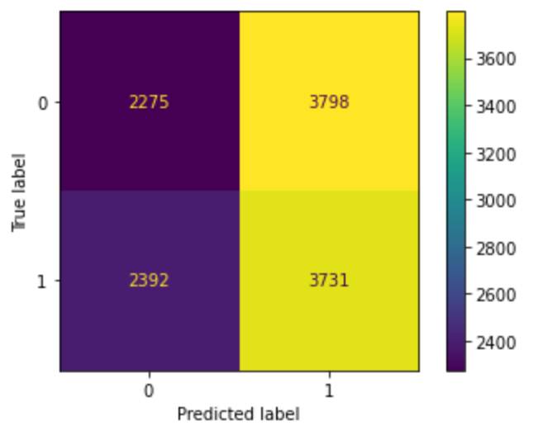
KNN
DT
GBDT (max_depth=5, learning_rate=0.2)
Confusion matrices from cross validation

Slide 14
Discussion
Overall, the KNN classifier produced the best performance (F1-score=66%) in the final model testing
Training and testing performance scores were very comparable with the final test scores indicating that there was no overfitting
However, a performance score of 66% indicated that there was room for further refinements in the model development
The final testing scores revealed improvements in recall (true positive) scores, which is a positive sign as a higher proportion of true positives (severity = injury) would be identified as positive
Confusion matrices for the selected algorithms confirmed the findings

Slide 15
Conclusions
Positive
Negative
Overall, the KNN classifier produced the best performance (F1-score=66%) in the final model testing
Models showed no overfitting
With a performance score of 66% indicated that the model development could be further improved

Slide 16
References
Assi, K., Rahman, S. M., Mansoor, U., & Ratrout, N. (2020). Predicting crash injury severity with machine learning algorithm synergized with clustering technique: A promising protocol. International Journal of Environmental Research and Public Health, 17(15), 5497. https://doi.org/10.3390/ijerph17155497
Bronshtein, A. (2019, May 6). A quick introduction to k-nearest neighbors algorithm. Medium. https://blog.usejournal.com/a-quick-introduction-to-k-nearest-neighbors-algorithm-62214cea29c7
Du, C.-J., & Sun, D.-W. (2008). Object classification methods. In D.-W. Sun (Ed.), Computer Vision Technology for Food Quality Evaluation (pp. 81–107). Academic Press. https://doi.org/10.1016/B978-012373642-0.50007-7
EliteDataScience. (2017, July 5). How to Handle Imbalanced Classes in Machine Learning. EliteDataScience. https://elitedatascience.com/imbalanced-classes
Gebresenbet, R. F., & Aliyu, A. D. (2019). Injury severity level and associated factors among road traffic accident victims attending emergency department of Tirunesh Beijing Hospital, Addis Ababa, Ethiopia: A cross sectional hospital-based study. PloS One, 14(9), e0222793. https://doi.org/10.1371/journal.pone.0222793
Huilgol, P. (2019, August 24). Accuracy vs. F1-Score. Medium. https://medium.com/analytics-vidhya/accuracy-vs-f1-score-6258237beca2
Moosavi, S., Samavatian, M. H., Parthasarathy, S., Teodorescu, R., & Ramnath, R. (2019). Accident risk prediction based on heterogeneous sparse data: New dataset and insights. Proceedings of the 27th ACM SIGSPATIAL International Conference on Advances in Geographic Information Systems, 33–42. https://doi.org/10.1145/3347146.3359078
Navlani, A. (2018, August 2). KNN classification using scikit-learn. DataCamp Community. https://www.datacamp.com/community/tutorials/k-nearest-neighbor-classification-scikit-learn
Ramya, S., Reshma, SK., Manogna, V. D., Saroja, Y. S., & Gandhi, G. S. (2019). Accident severity prediction using data mining methods. International Journal of Scientific Research in Computer Science Engineering and Information Technology, 5(2), 528–536. https://doi.org/10.32628/CSEIT195293
Sam, E. F., Blay, D. K., Antwi, S., Anaafi, C., & Adoma, J. A. (2019). Pre-hospital and trauma care to road traffic accident victims: Experiences of residents living along accident-prone highways in Ghana. In Emergency Medicine and Trauma. IntechOpen. https://doi.org/10.5772/intechopen.86118

Slide 17
References …
Sanjay, M. (2020, August 19). Why and how to cross validate a model? Medium. https://towardsdatascience.com/why-and-how-to-cross-validate-a-model-d6424b45261f
Serengil, S. (2020, April 6). Feature importance in decision trees. Sefik Ilkin Serengil. https://sefiks.com/2020/04/06/feature-importance-in-decision-trees/
StackExchange. (n.d.). Combining Latitude/Longitude position into single feature—Data Science Stack Exchange. Retrieved September 4, 2020, from https://datascience.stackexchange.com/questions/49553/combining-latitude-longitude-position-into-single-feature
Tyagi, P. (2019, January 7). Decision Tree. Medium. https://medium.com/@pytyagi/decision-tree-ac0c9e3b8258
Vickery, R. (2020, April 28). The art of finding the best features for machine learning. Medium. https://towardsdatascience.com/the-art-of-finding-the-best-features-for-machine-learning-a9074e2ca60d
Xuan, P., Sun, C., Zhang, T., Ye, Y., Shen, T., & Dong, Y. (2019). Gradient boosting decision tree-based method for predicting interactions between target genes and drugs. Frontiers in Genetics, 10, 1–11. https://doi.org/10.3389/fgene.2019.00459

